Slide 1
Whats Eating My Roses

Slide 2
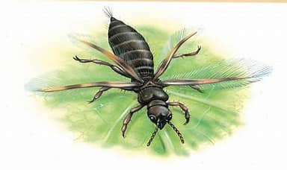
Chili Thrips
(Scirtothrips dorsalis) are small pests that can cause significant
damage to a wide range of plants, particularly in horticulture.

Slide 3
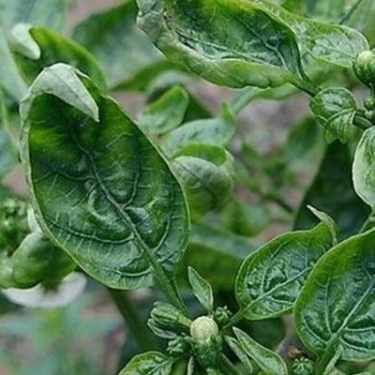
Identification
Chili thrips are tiny insects, typically measuring about 1/16 inch
(0.5 to 1.2 mm) in length. They are pale cream to light brown in color, with dark gray eyes and fringed wings. Males are generally smaller
and paler than females. Immature chili thrips resemble adults but lack
wings and have red eyes. They are often difficult to spot due to their
small size and the secluded areas they inhabit on plants, such as
unopened flower buds and leaf axils.

Slide 4
Host Plants and Damage
Chili thrips are known to attack over 100 plant species, including popular crops
like chili peppers, tomatoes, strawberries, and various ornamental plants. Their
feeding behavior involves rasping and sucking plant tissue, which leads to
symptoms such as:
Bronzed, curled, and distorted leaves: This damage can resemble herbicide burn.
Premature leaf drop: Severe infestations can lead to significant defoliation.
Scarring on flowers: Affected flowers may show signs of distortion and scarring.

Slide 5
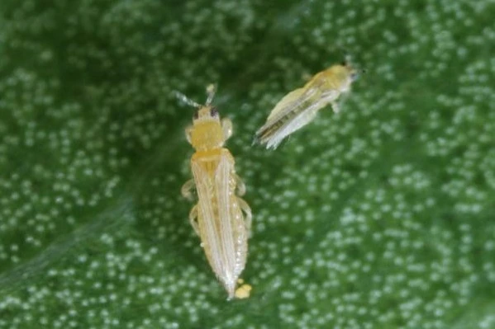
Lifecycle
The lifecycle of chili thrips includes four stages: egg, larva, pupa, and adult. Female thrips lay eggs inside plant tissue, and the larvae feed on
the plant, going through two instars before pupating. The entire
lifecycle can be completed in about two weeks, depending on
environmental conditions.

Slide 6
Management Strategies
Effective management of chili thrips involves a combination of
cultural, biological, and chemical strategies:

Slide 7
Monitoring:
Regularly inspect plants for signs of thrips damage and presence.

Slide 8
Cultural Practices:
Maintain plant health through proper watering, fertilization, and
pruning to reduce stress and susceptibility to pests.

Slide 9
Biological Control:
Introduce natural predators, such as ladybugs and lacewings, which
can help keep thrips populations in check.

Slide 10
Chemical Control:
Insecticides like imidacloprid can be effective, but care should be taken to avoid harming beneficial insects. Always follow label instructions
and consider using insecticides that are less harmful to natural
predators.
By understanding the biology and behavior of chili thrips, gardeners and
farmers can implement effective strategies to protect their crops and
minimize damage. Regular monitoring and timely intervention are key to managing this pest successfully.

Slide 11
Rose Rosette Disease
Rose Rosette Disease (RRD) is caused by the rose rosette virus, which is transmitted by the microscopic eriophyid mite
Has been more prominent in the Dallas Ft Worth area since 2011

Slide 12
Compare Normal New Growth on Rose to Diseased Roses
Normal plant development starts off red and then turns green
Weather and sun light determines how long it takes for the color to change.

Slide 13
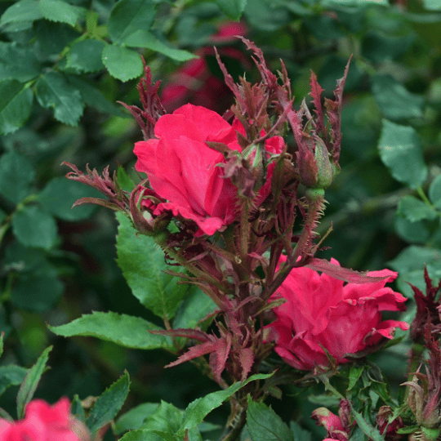
Symptoms Associated
Witches broom
Witches’ broom is a growth found on many types of plants, commonly on roses, in which a stem branches off into a bundle of offshoots, often appearing like a broom or bird’s nest. This deformity is often a symptom of a disease.

Slide 14
Malformation flowers and leaves

Slide 15
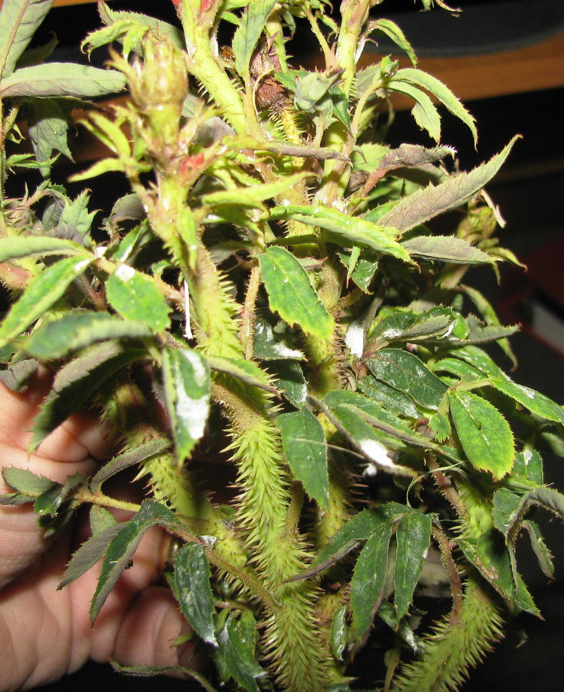
Excessive leaf growth
Excessive thorniness

Slide 16
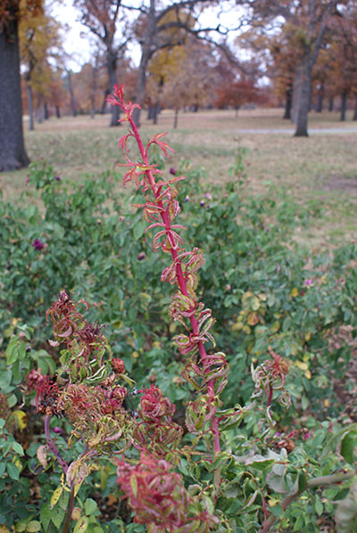
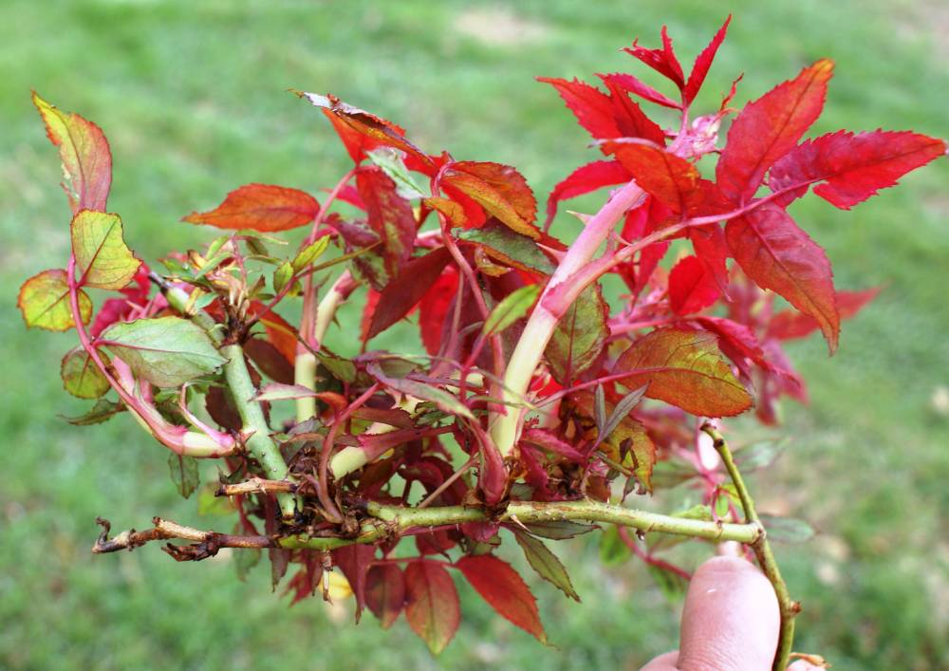
Red discoloration,
Lateral shoot elongation,

Slide 17
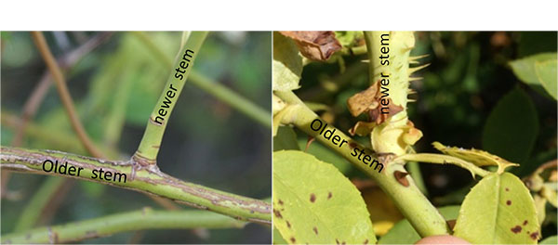
Thicker Stem
On a normal cane (left), the new shoot has a smaller diameter than the older growth. RRD may cause a thickening of the stem (right), so the newer growth is thicker and more succulent than older growth.

Slide 18
Symptoms are variable on different roses.
For example, red shoots do not occur in some ornamental rose varieties and there is a lack of excessive thorns on multiflora roses.

Slide 19
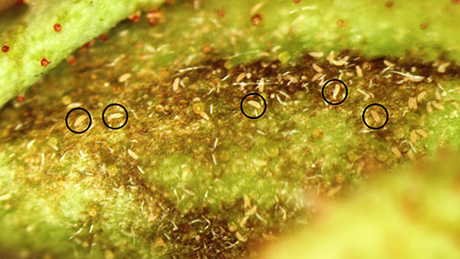
Caused by Eriophyid Mites
The eriophyid mites that transmit RRV are microscopic. Eriophyid mites are present on this magnified rose bud and a few are circled.

Slide 20
Cause:
The disease is caused by a plant virus, the rose rosette virus (RRV). This virus has not been transmitted by sap; it is transmitted by grafting or feeding of eriophyid mites. Phyllocoptes fructiphilus is the primary arthropod that transmits RRV. This mite is microscopic and tends to hide in buds, on open flowers and sepals, at the base of shoots, leaf axils, or under leaf scars.

Slide 21
Eriophyid Mites
The mite acquires RRV when it feeds on infected plants. The disease is transmitted when an infective mite vector feeds on the plant. A few weeks to months after infection, plants will begin to develop symptoms of RRD. The mites crawl short distances on rose plants, but they can be carried further distances by wind currents, blowing to new roses. Infective mites can also be carried to new sites on gloves, clothing, or tools. Both the mite and virus are specific to roses (Rosa spp.); no other hosts have been identified. The mites survive the winter by hiding near or within buds, spent flowers, leaf axils, or leaf scars. The virus may be inactive during the winter, but symptoms will appear on new growth emerging in the spring.

Slide 22
Management
Management of RRD requires a multistep approach and uses integrated pest management . All landscape roses are thought to be susceptible to RRV. Studies are in progress to determine if resistance or tolerance is present in cultivated roses. There is no cure once a plant is infected.

Slide 23
Management
Growers have attempted to remove symptomatic canes by pruning, however pruning is often ineffective. The microscopic mites may remain on the plant and/or recently infected canes, which may not exhibit symptoms for many months or the virus may survive in the root system. Therefore, it is recommended to remove symptomatic plants at the first evidence of the disease, including the root ball. Dead heading roses throughout the season may be useful since mites accumulate around the open blooms. Maintaining proper health and vigor of roses in the landscape may be helpful.

