Slide 1
Tools in the garden

Slide 2
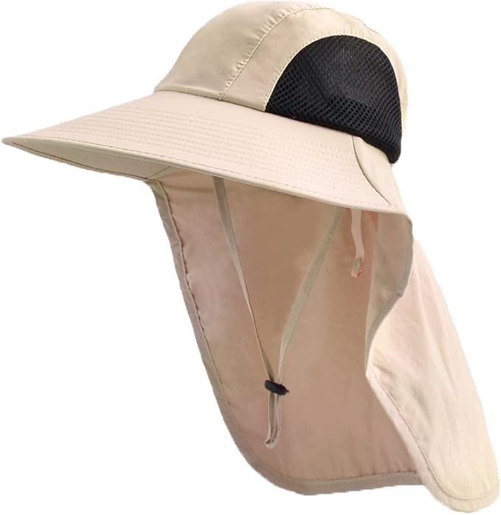
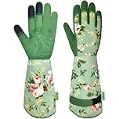
Set up for Safety
Sun Screen
Hats
Arm protection Protects scratches and sun
Gloves Keeps the dirt out of finger nails and protects from cuts and scratches
Amazon $8.99
Amazon $14.99
Ace $32.49 Target $15.00

Slide 3
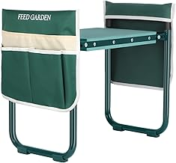
Make it easy
Garden Kneeler and Seat,
Amazon $34.99
Target $39.99

Slide 4
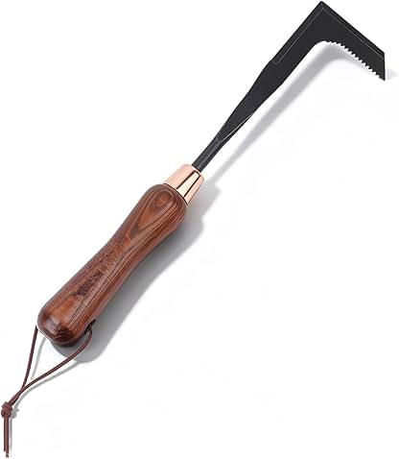
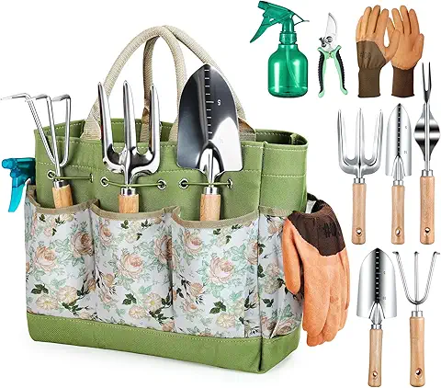
Clearing the area
Crack Weeder
Tools and caddy
Amazon $15.99
Amazon $35.00
Target$45.00 10 peice
$20. 3 piece set

Slide 5
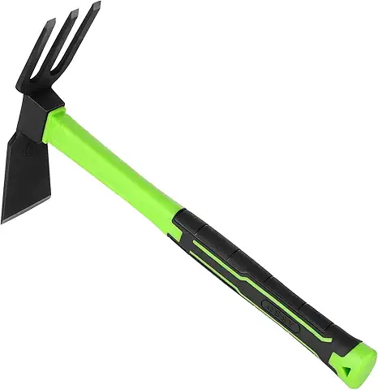

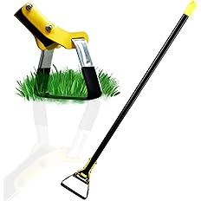
Planting
Trowels
Cultivator
Shovels Trench Blade
Scuffle Garden Hoes for Weeding
Amazon $21.
Amazon $ 30.00
Amazon $23.99

Slide 6
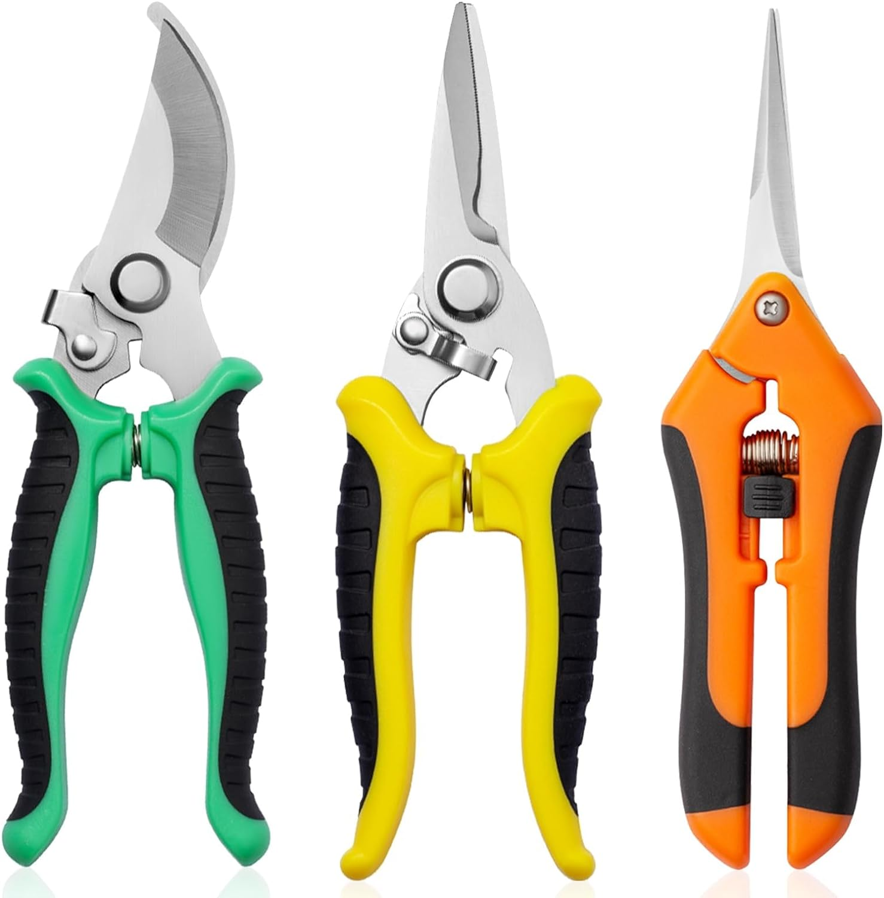
Pruning

Slide 7
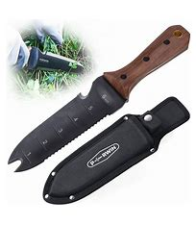
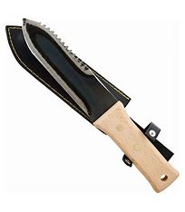
Prevent weeds
Hokuru Hori Hori Knife
Amazon $20
Territorial $44

Slide 8
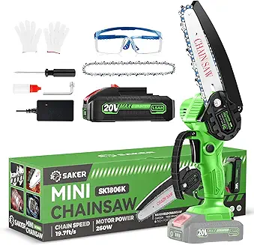
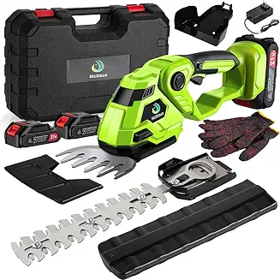
Trimming
Small chain saw
Cordless hedge trimmer
Amazon $ 29.99
Amazon $59.95

Slide 9
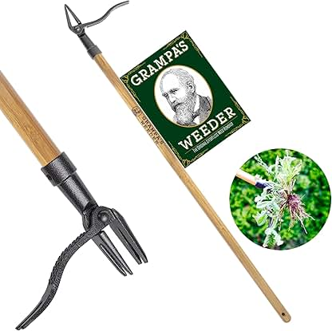
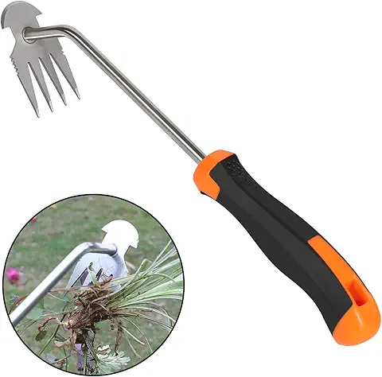
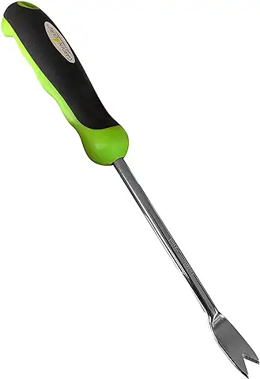
Weeding
Grampa's Weeder - The Original Stand Up Weed Puller Tool with Long Handle
Weed puller
Then Claw
Dandeline weeder
Amazon $39.97
Amazon $19.99
Amazon $14.99

Slide 10
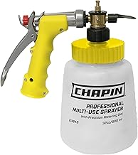
Feeding
Chapin G364D Made in The USA 32 Ounce Professional Lawn and Garden Hose-End Sprayer with 16 Mixing Rations on The Metering Dial, Built-in Anti-Siphon, Translucent
Tractor Supply co $25.19
Plants for all season

Slide 11
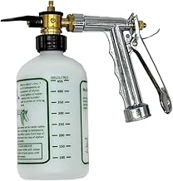
Rocky Mountain Goods Hose Sprayer - 16oz Bottle - Small 7.5" x 7.5" Size - for Spraying Fertilizer, Soap, Pesticide, Chemical, Insecticide - Dilution Adjuster - Nozzle Angle Guide

Slide 12
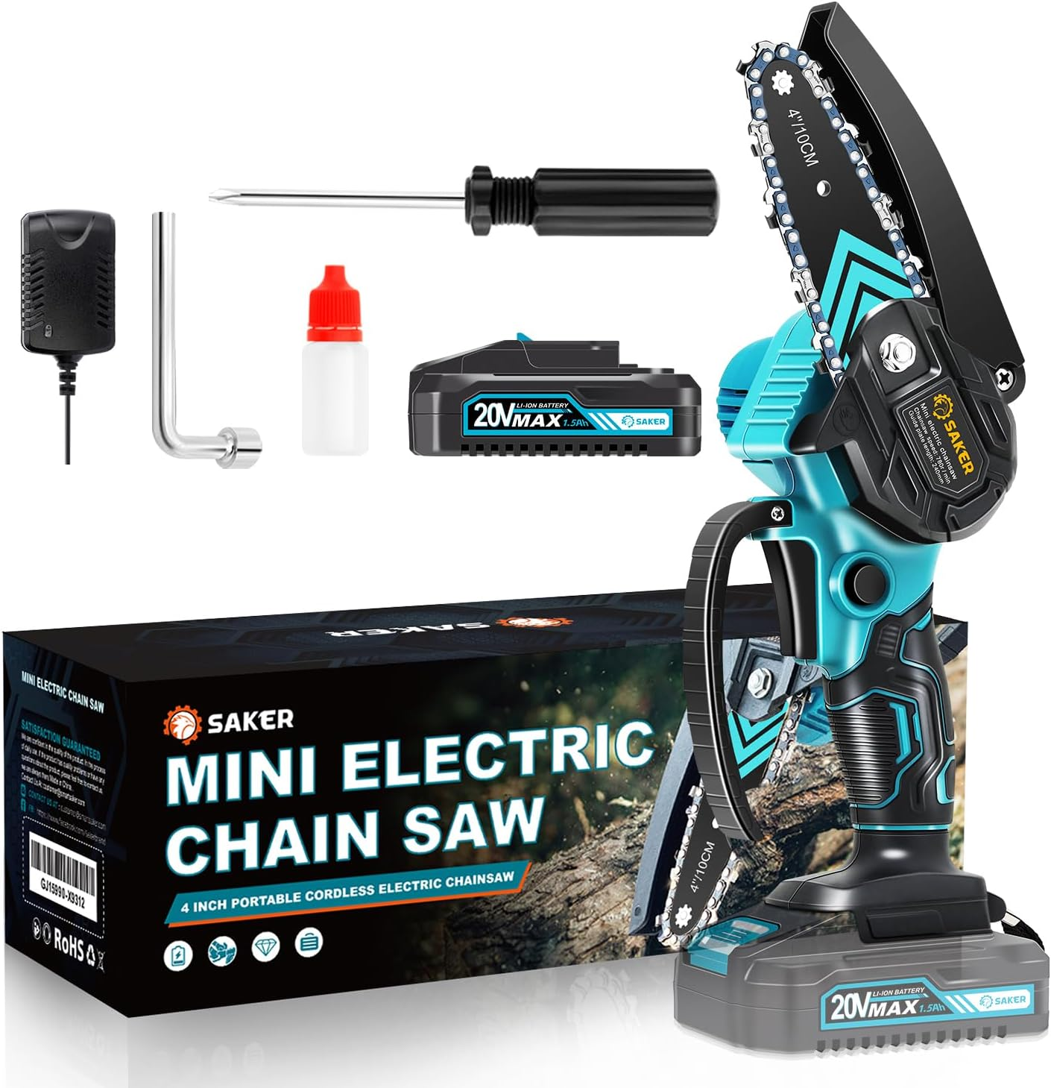
Cutting limbs
Saker Mini Chainsaw,Portable Electric Chainsaws

Slide 13
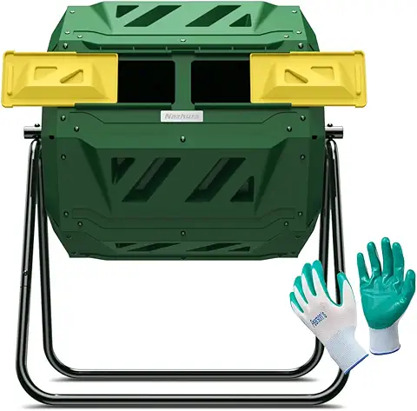
Mulch bins
Compost Tumbler Bin Composter Dual Chamber 43 Gallon

Slide 14
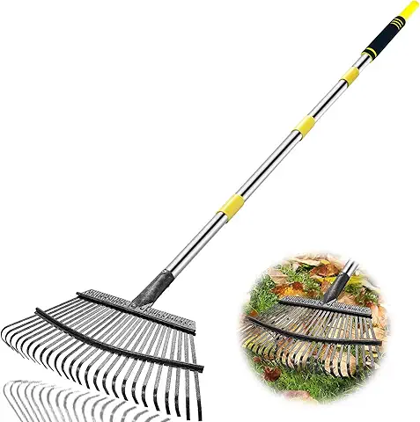
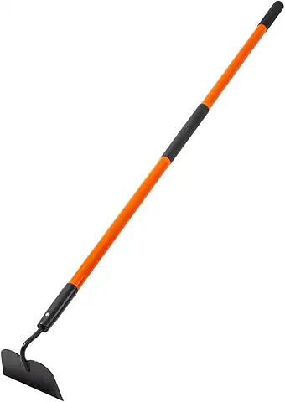
Rakes Hoes

Slide 15
Probes
Water
PH
Tempature
Agrlife testing Soil Testing Lab – Soil, Water and Forage Testing Laboratory

Slide 16
Cages and netting

